Slide 1
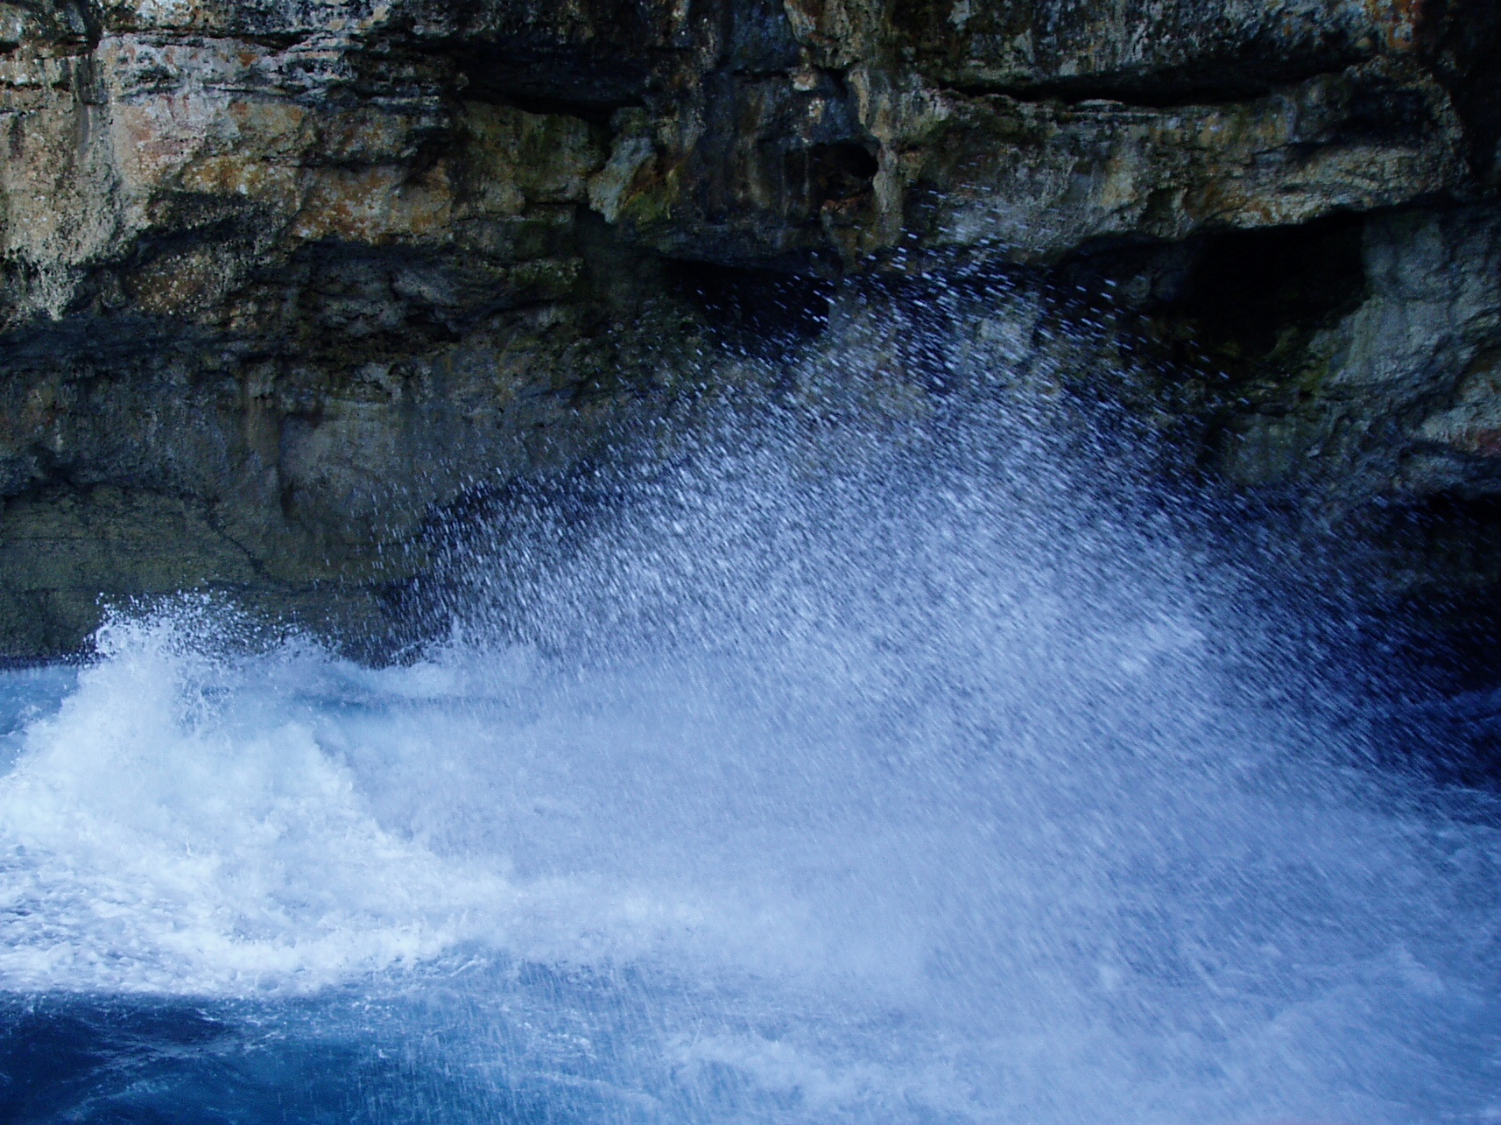
Lord Jesus Christ,
we confess we have failed you as did your first disciples.
We ask for your mercy and your help.
Our selfishness betrays you:
Lord, forgive us.
All Christ have mercy.

Slide 2
We fail to share the pain of your suffering:
Lord, forgive us.
All Christ have mercy.

Slide 3
We run away from those who abuse you:
Lord, forgive us.
All Christ have mercy.

Slide 4
We are afraid of being known to belong to you: Lord, forgive us.
All Christ have mercy.

