Slide 1
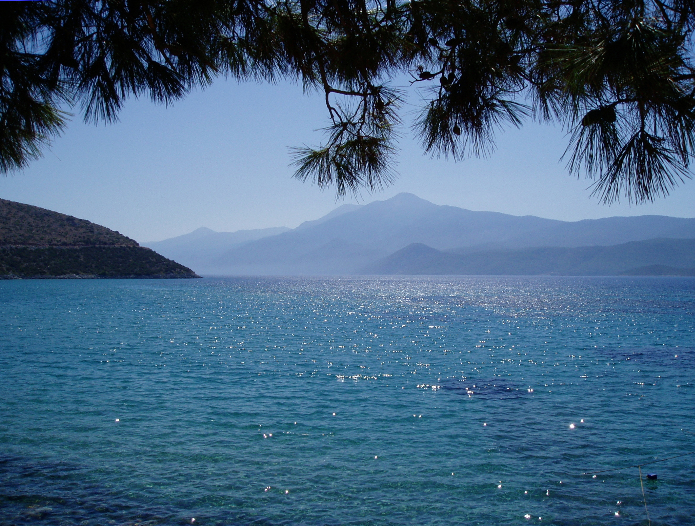
Jesus Christ, risen Master and triumphant Lord,
we come to you in sorrow for our sins,
and confess to you our weakness and unbelief.
We have lived by our own strength,
and not by the power of your resurrection.
In your mercy, forgive us.
All Lord, hear us and help us.

Slide 2
We have lived by the light of our own eyes,
as faithless and not believing.
In your mercy, forgive us.
All Lord, hear us and help us.

Slide 3
We have lived for this world alone,
and doubted our home in heaven.
In your mercy, forgive us.
All Lord, hear us and help us.

