Slide 1
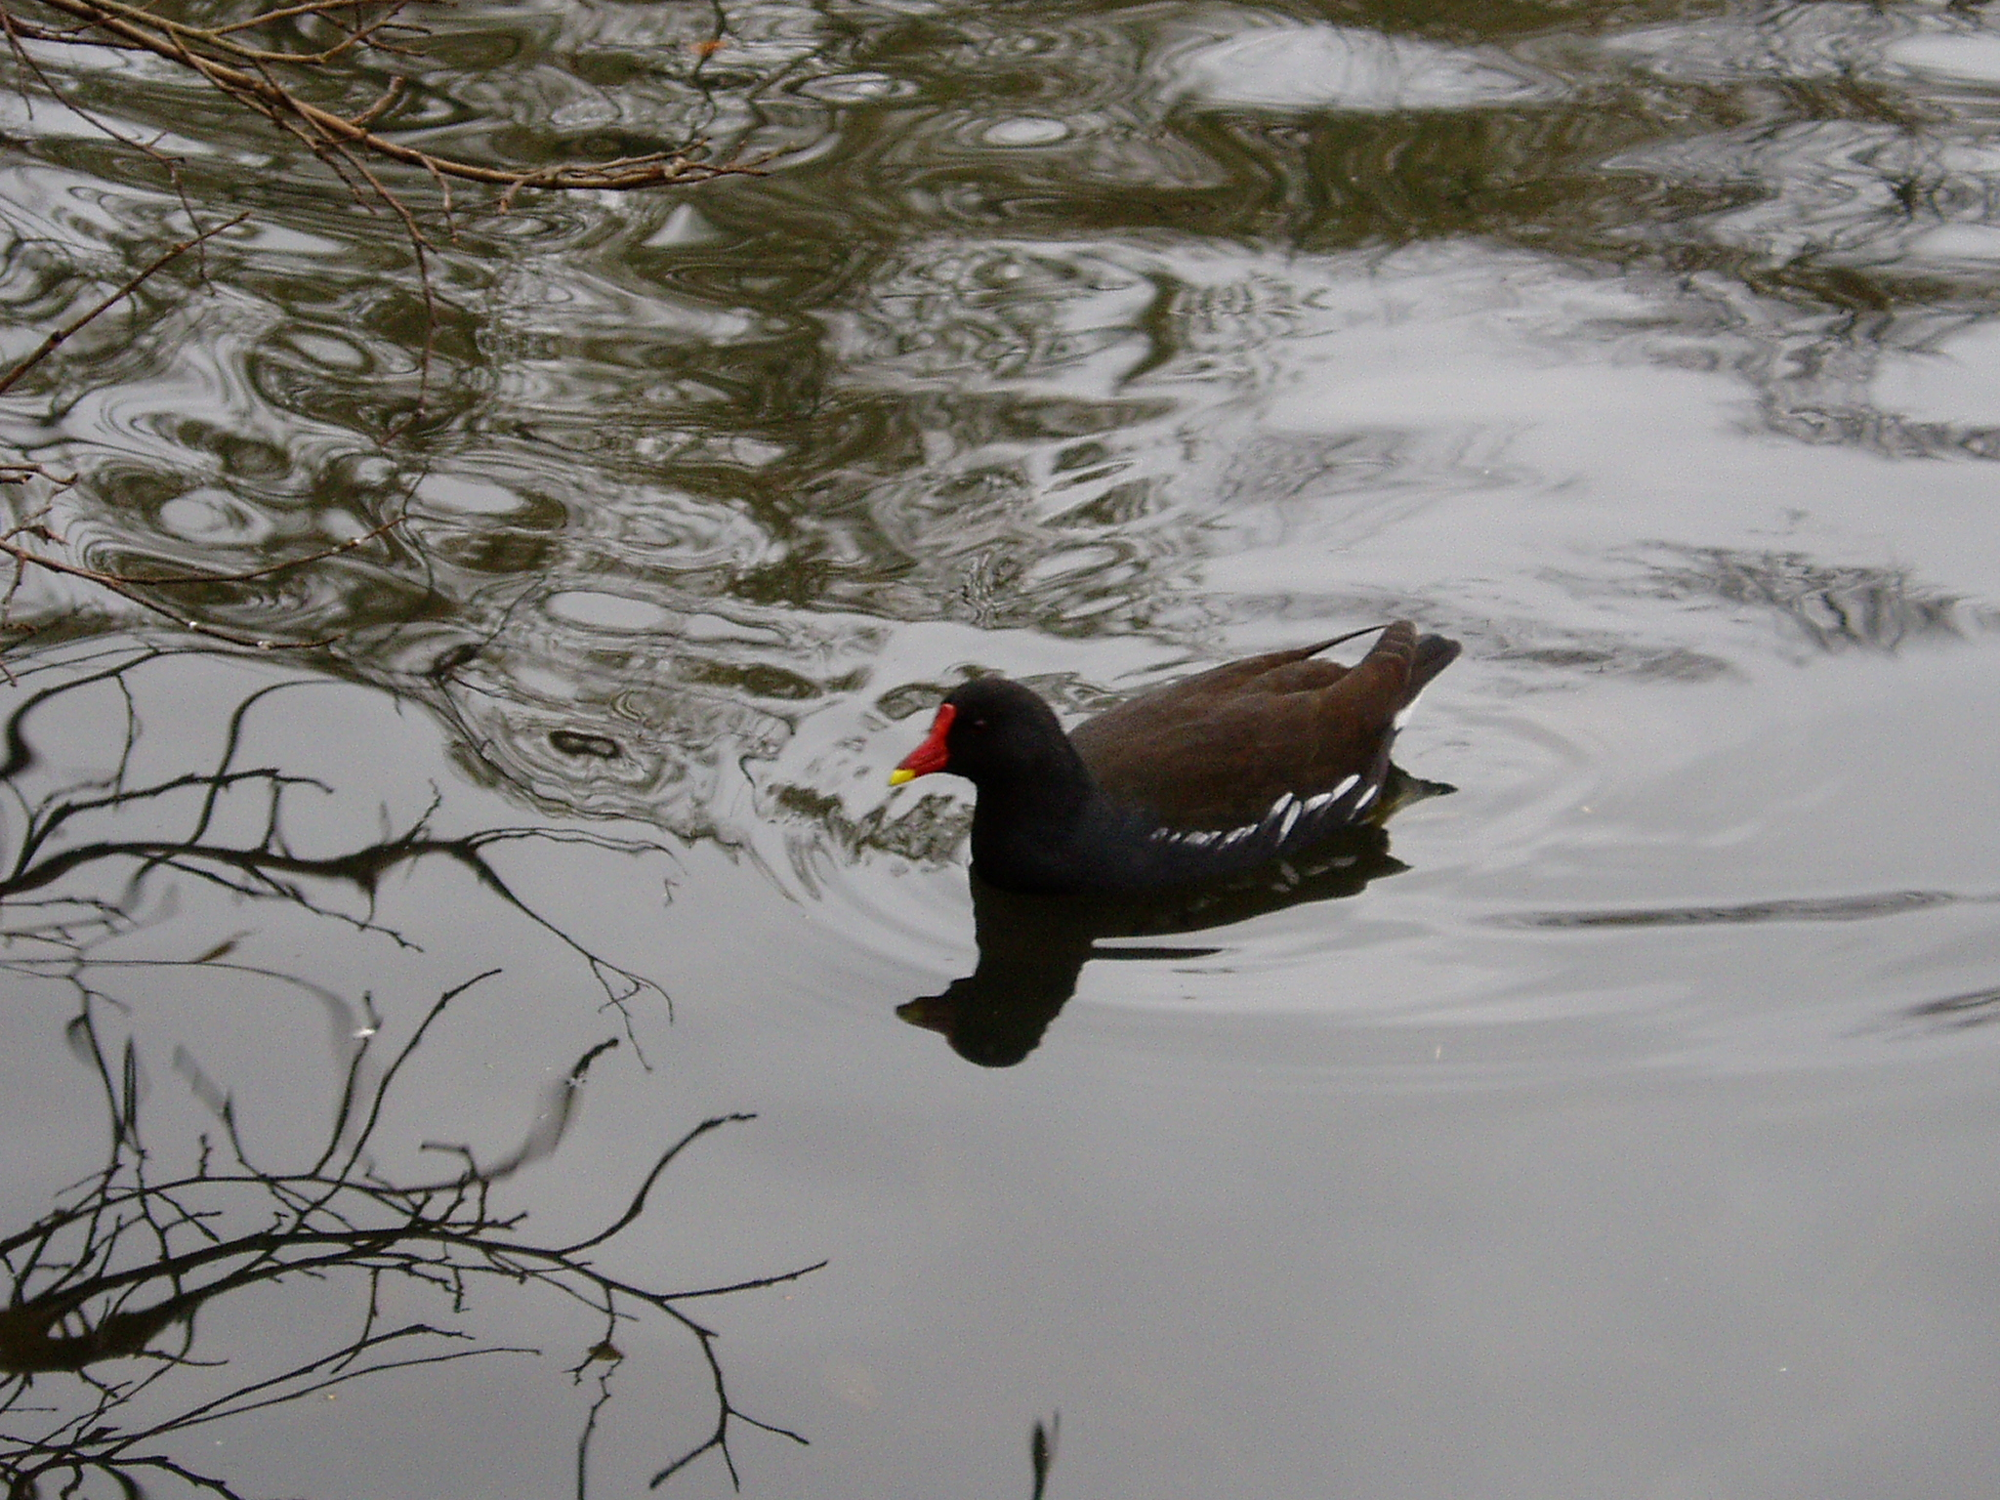
We confess our sin, and the sins of our society,
in the misuse of God's creation.
God our Father, we are sorry
for the times when we have used your gifts carelessly,
and acted ungratefully.
Hear our prayer, and in your mercy:
All forgive us and help us.

Slide 2
We enjoy the fruits of the harvest,
but sometimes forget that you have given them to us.
Father, in your mercy:
All forgive us and help us.
We belong to a people who are full and satisfied,
but ignore the cry of the hungry.
Father, in your mercy:
All forgive us and help us.

Slide 3
We are thoughtless,
and do not care enough for the world you have made.
Father, in your mercy:
All forgive us and help us.
We store up goods for ourselves alone,
as if there were no God and no heaven.
Father, in your mercy:
All forgive us and help us.

