Slide 1
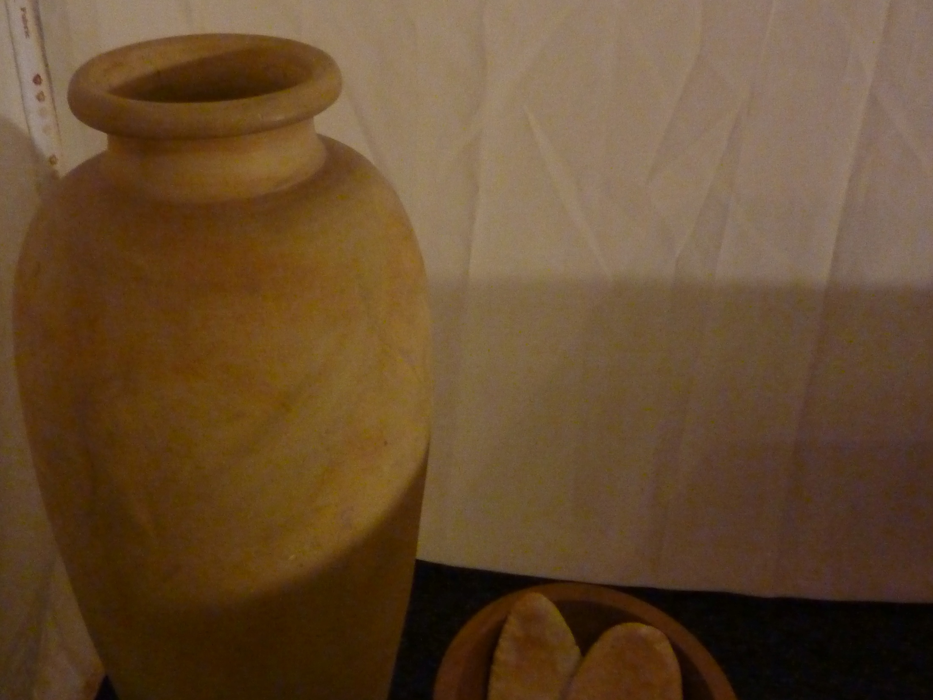
Lord God, our maker and our redeemer,
this is your world and we are your people:
come among us and save us.
We have wilfully misused your gifts of creation;
Lord, be merciful:
All forgive us our sin.

Slide 2
We have seen the ill-treatment of others
and have not gone to their aid;
Lord, be merciful:
All forgive us our sin.
We have condoned evil and dishonesty
and failed to strive for justice;
Lord, be merciful:
All forgive us our sin.

Slide 3
We have heard the good news of Christ,
but have failed to share it with others;
Lord, be merciful:
All forgive us our sin.
We have not loved you with all our heart,
nor our neighbours as ourselves;
Lord, be merciful:
All forgive us our sin.

