Slide 1
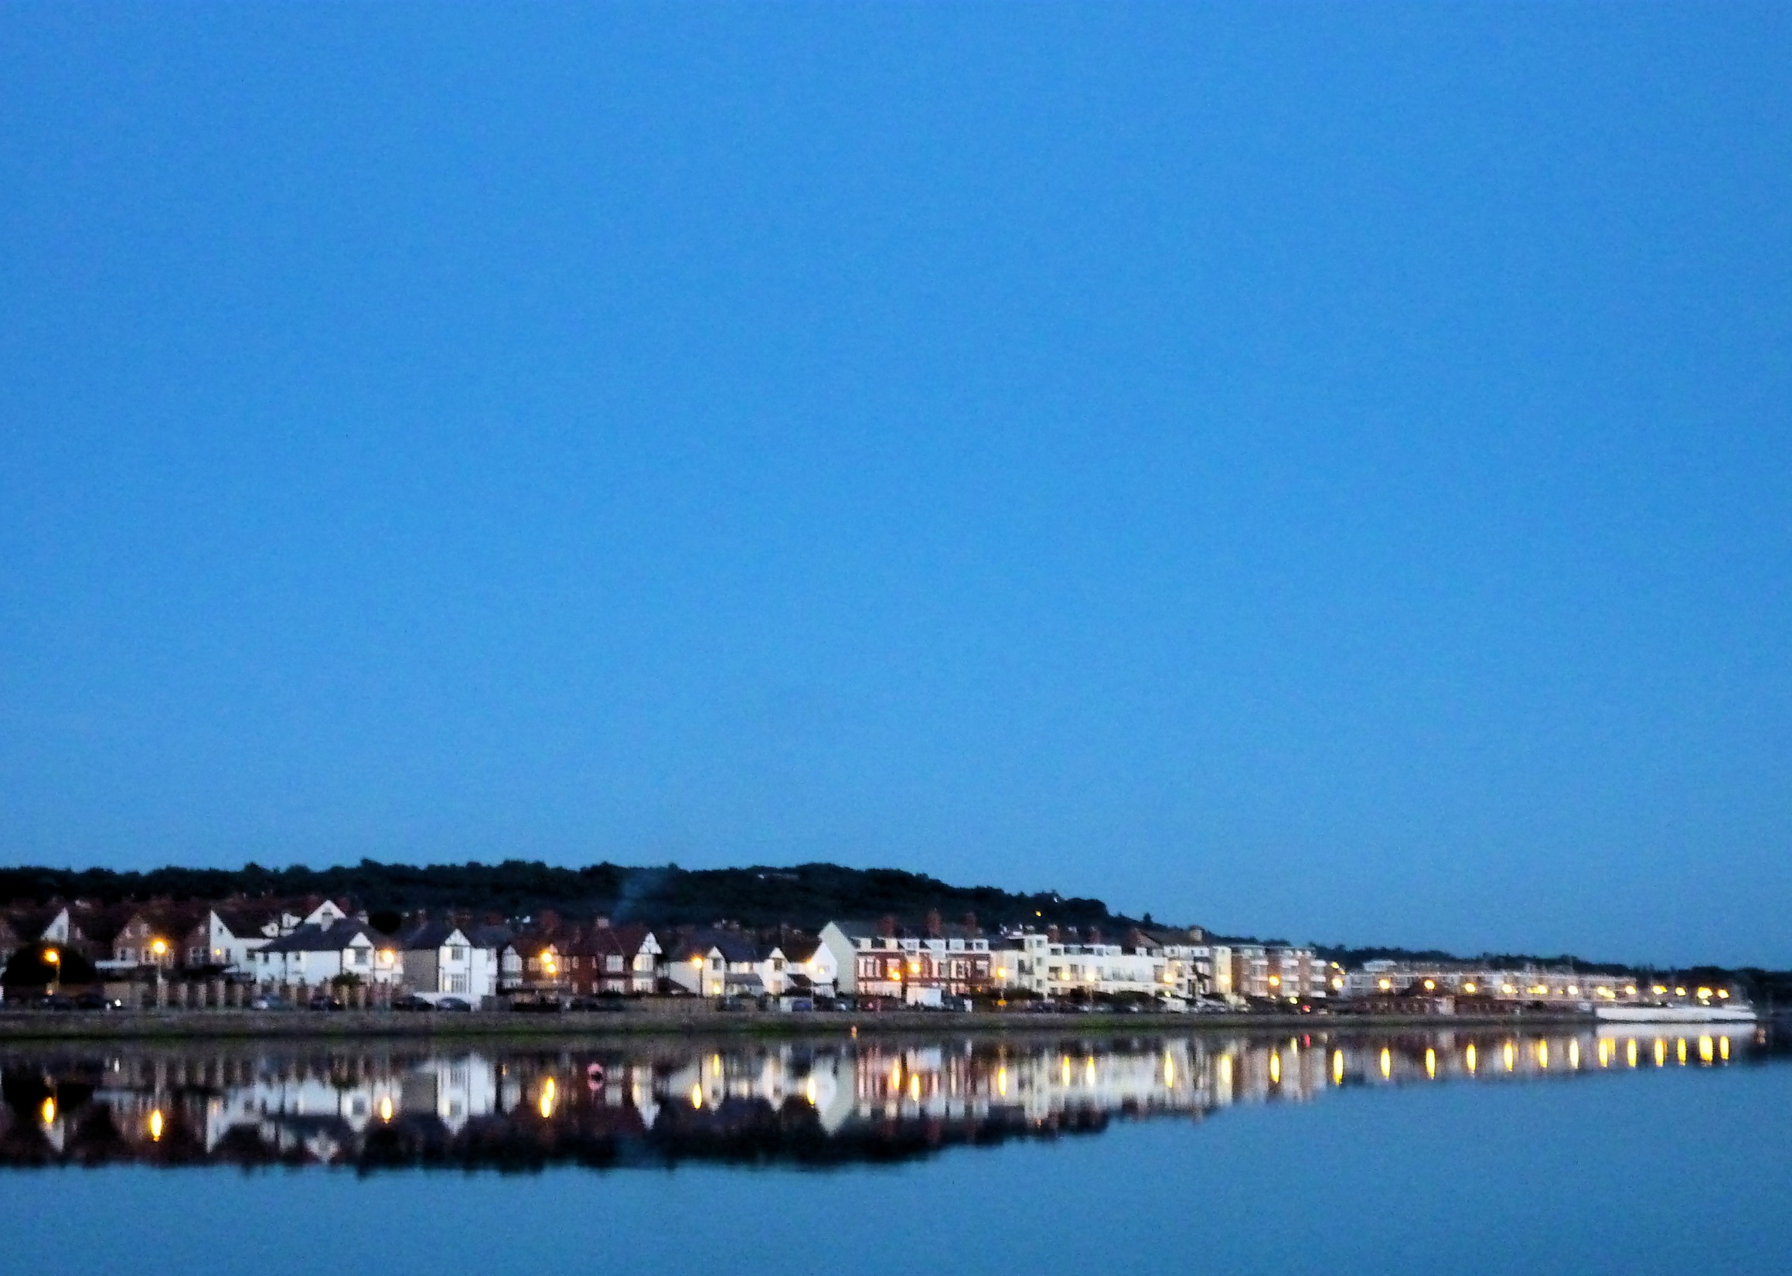
Let us return to the Lord our God and say to him:
Father,
we have sinned against heaven and against you.
We are not worthy to be called your children.
We turn to you again

Slide 2
Have mercy on us,
bring us back to yourself as those who were once dead
but now have life through
Christ our Lord.
Amen

