Slide 1
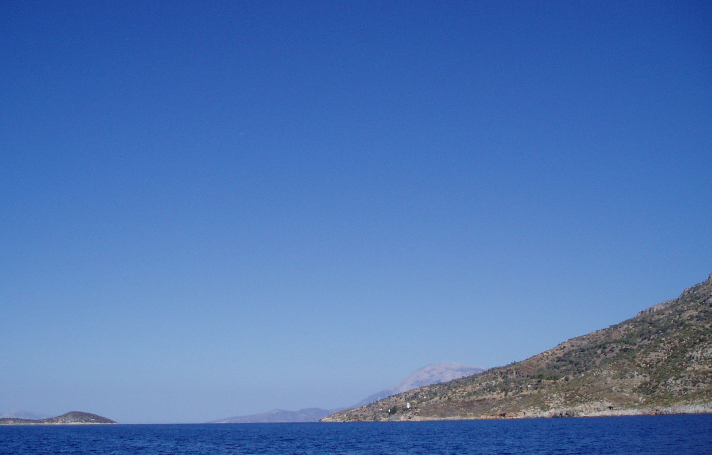
Come, let us return to the Lord and say:
All Lord our God,
in our sin we have avoided your call.
Our love for you is like a morning cloud,
like the dew that goes away early.
Have mercy on us;
deliver us from judgement;
bind up our wounds and revive us;
in Jesus Christ our Lord.
Amen.

