Slide 1
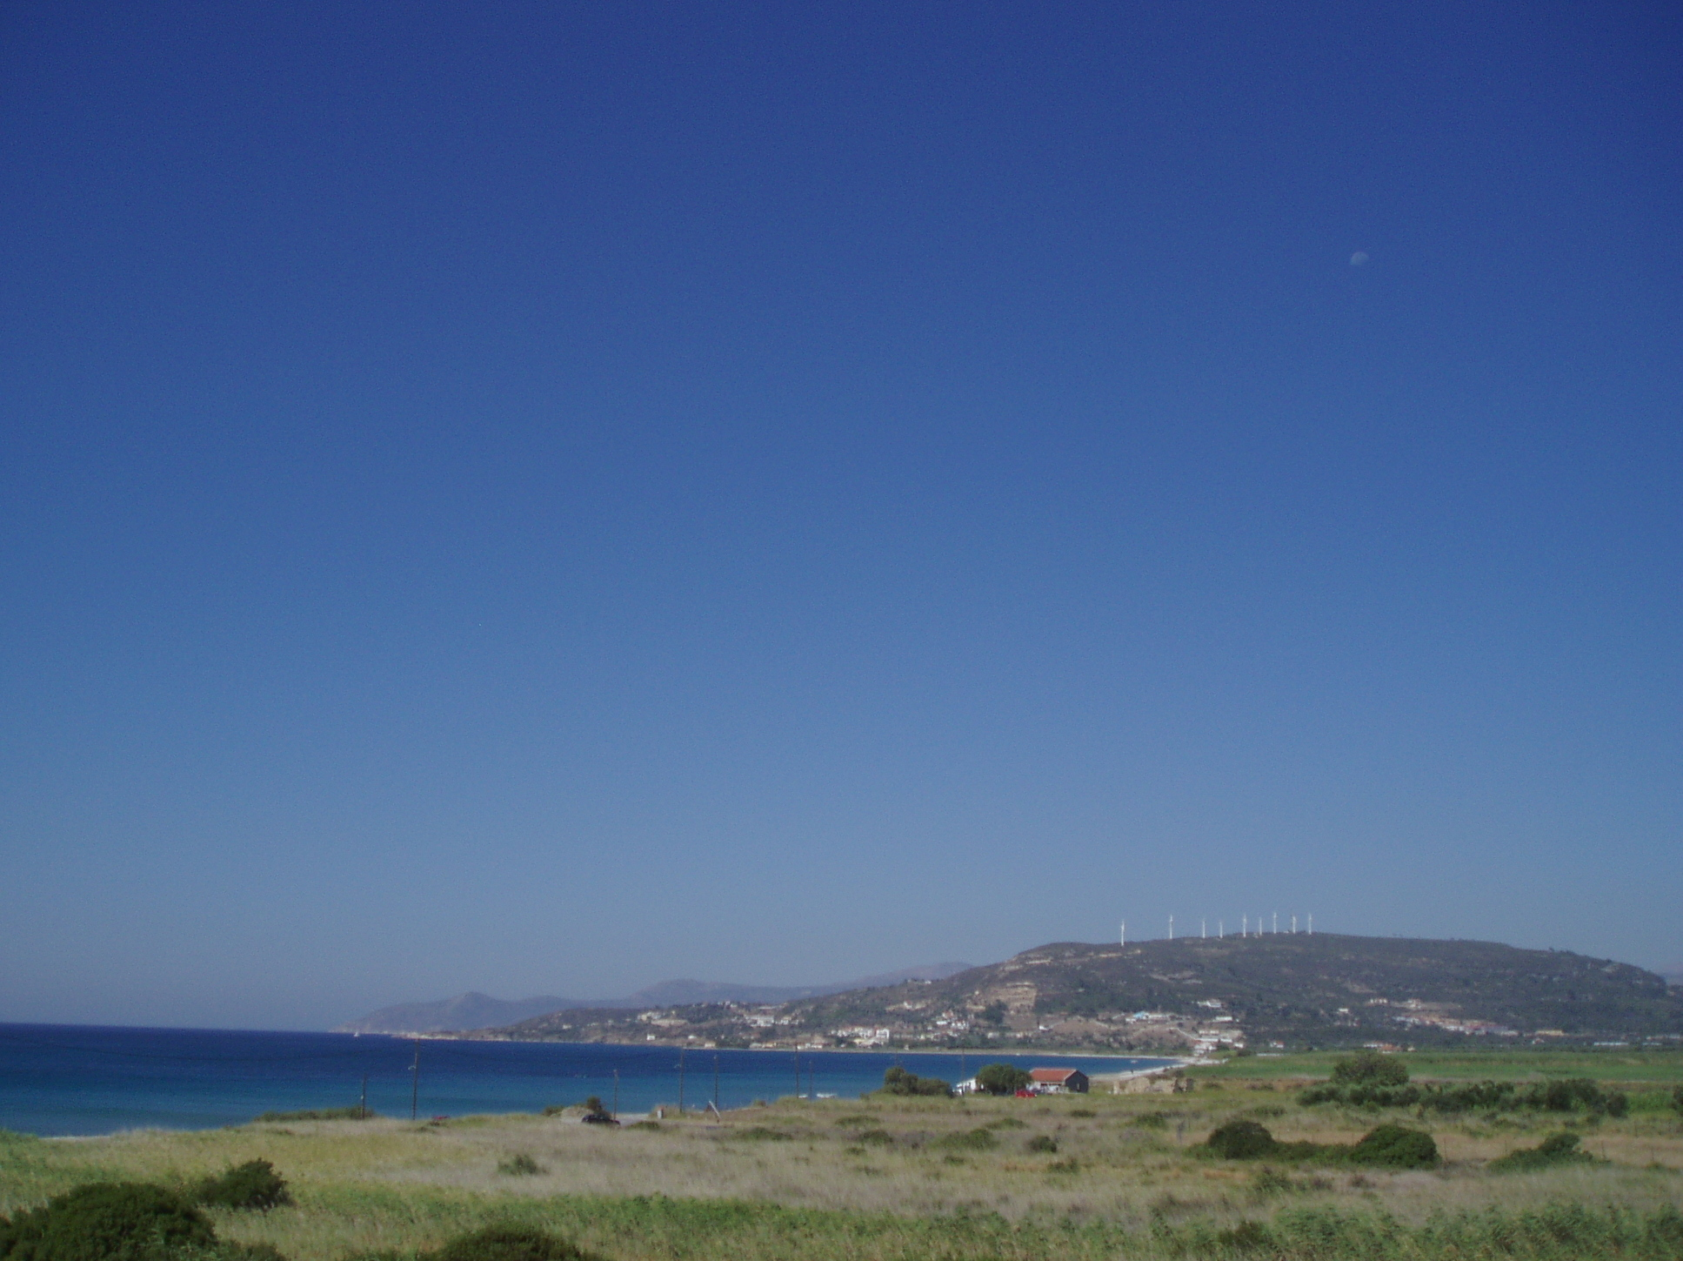
God our Father,
we come to you in sorrow for our sins.
For turning away from you,
and ignoring your will for our lives;
Father, forgive us:
All save us and help us.

Slide 2
For behaving just as we wish,
without thinking of you;
Father, forgive us:
All save us and help us.

Slide 3
For failing you by what we do,
and think and say;
Father, forgive us:
All save us and help us.

Slide 4
For letting ourselves be drawn away from you by temptations in the world about us;
Father, forgive us:
All save us and help us.

Slide 5
For living as if we were ashamed
to belong to your Son;
Father, forgive us:
All save us and help us.

