Slide 1
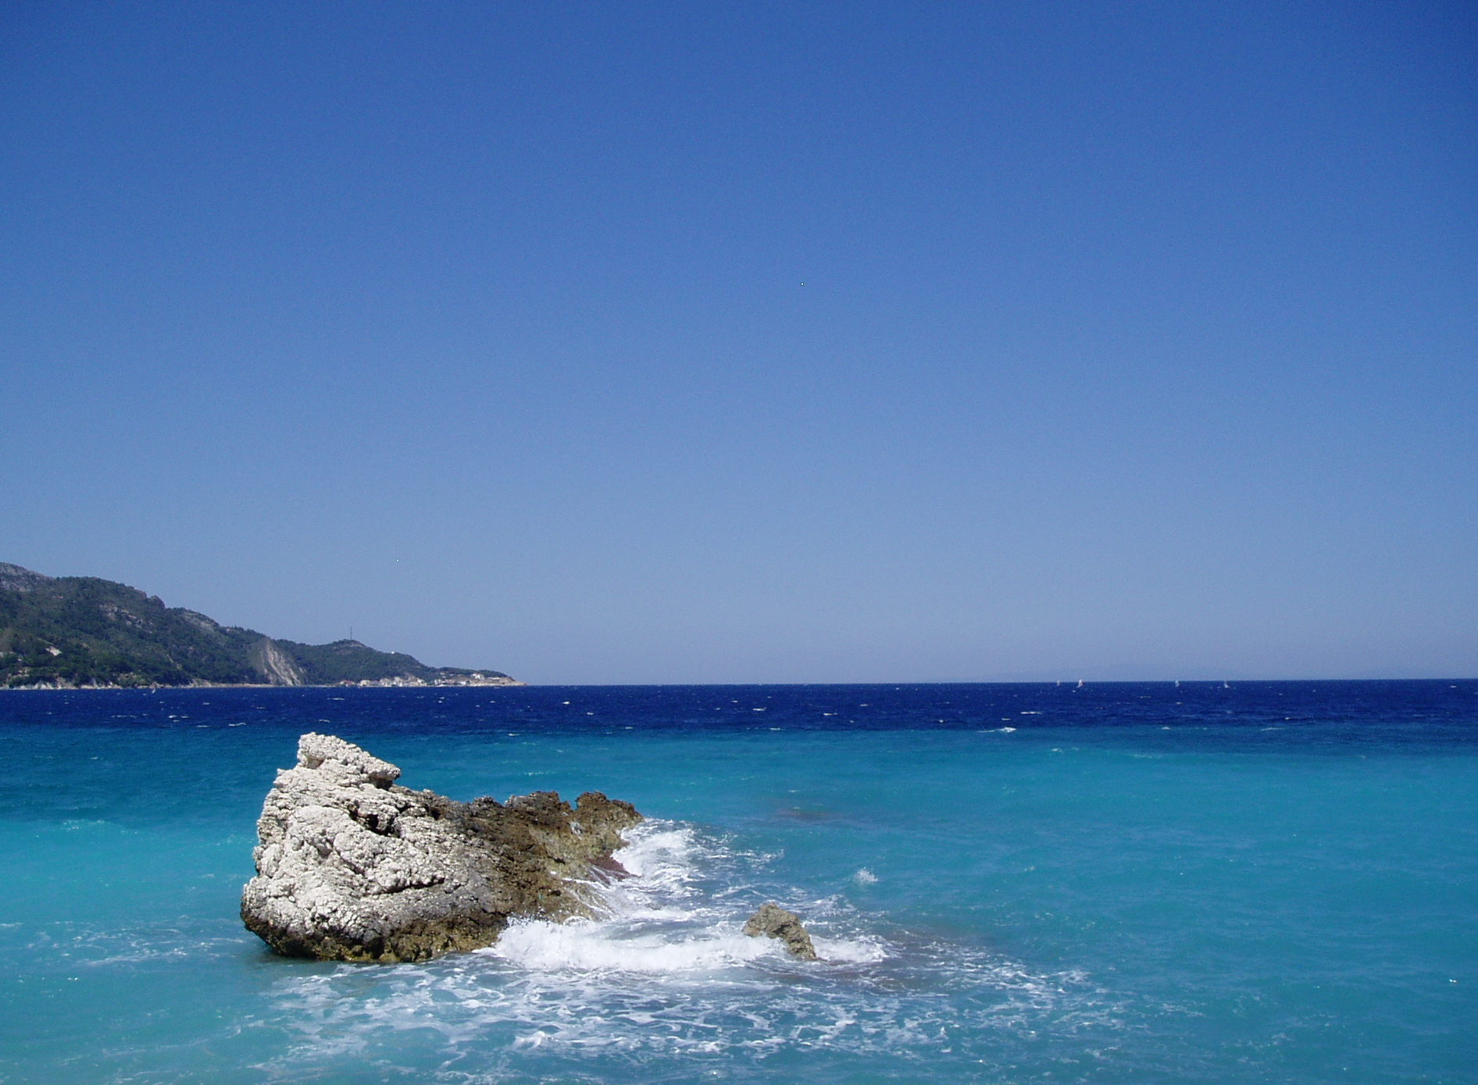
All Almighty and most merciful Father,
we have wandered and strayed from your ways like lost sheep.
We have followed too much the devices and desires of our own hearts.
We have offended against your holy laws.

Slide 2
We have left undone those things
that we ought to have done;
and we have done those things
that we ought not to have done;
and there is no health in us.
But you, O Lord, have mercy upon us sinners.

Slide 3
Spare those who confess their faults.
Restore those who are penitent,
according to your promises
declared to mankind
in Christ Jesus our Lord.

Slide 4
And grant, O most merciful Father, for his sake,
that we may live a disciplined, righteous and godly life,
to the glory of your holy name.
Amen.

