Slide 1
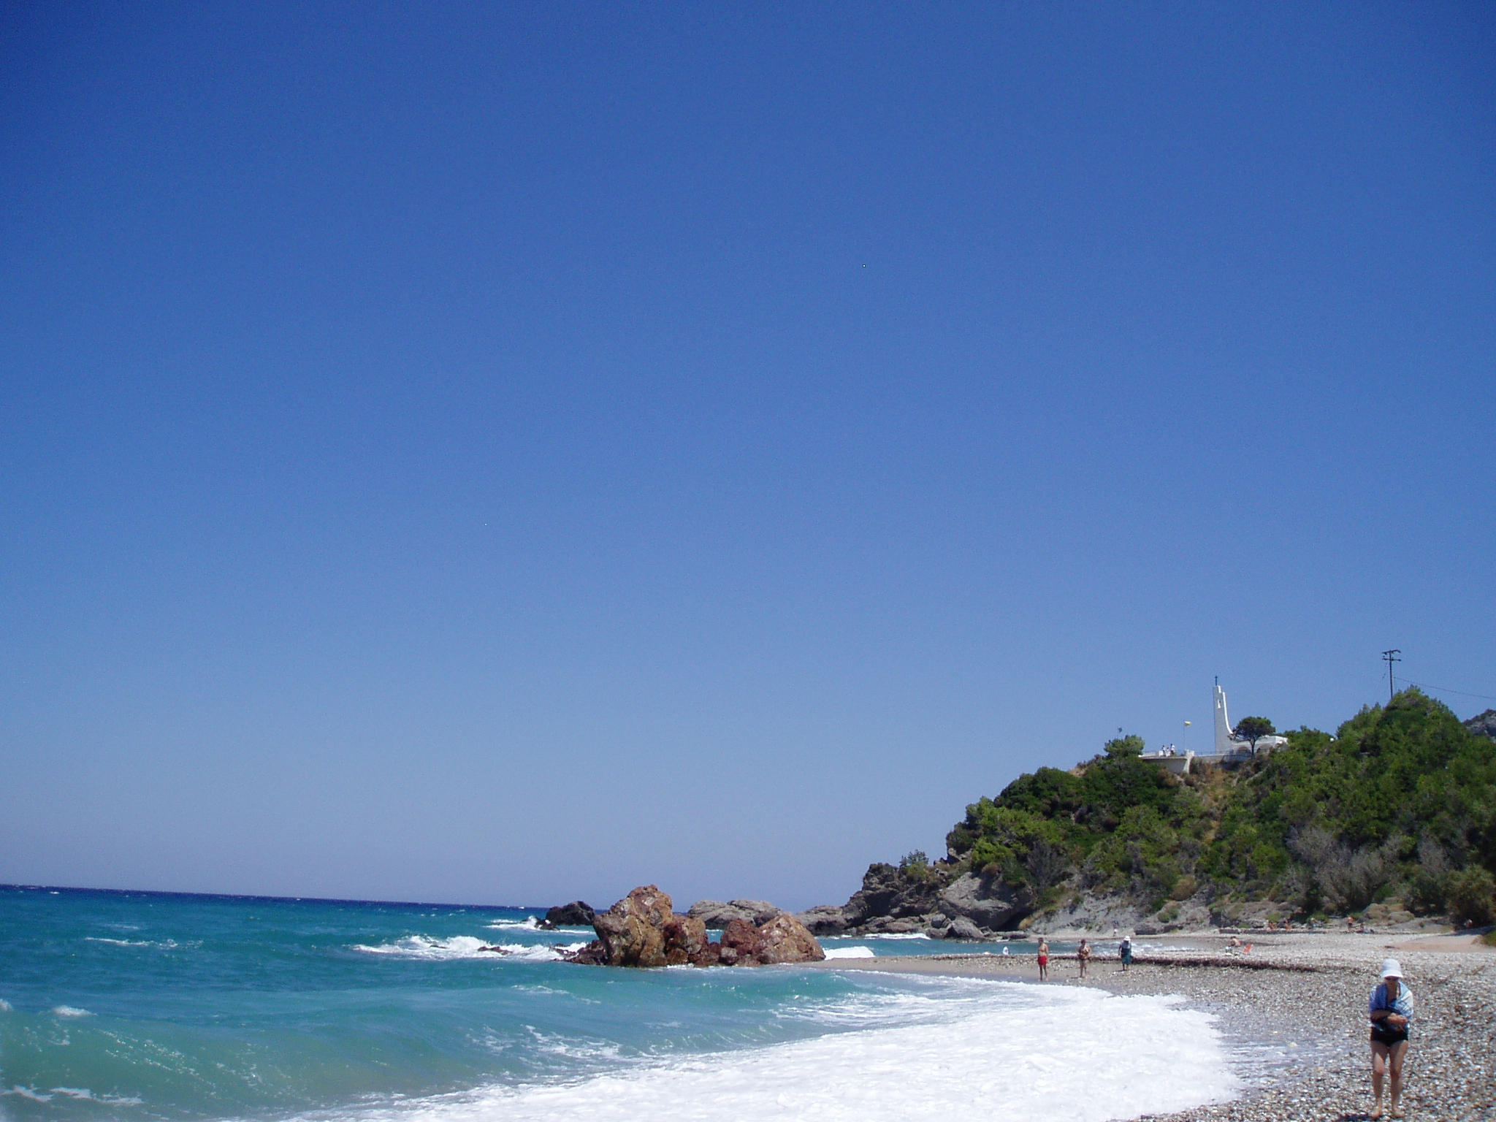
All Almighty God,
Father of our Lord Jesus Christ,
maker of all things, judge of all people,
we acknowledge and confess
the grievous sins and wickedness
which we have so often committed
by thought, word and deed
against your divine majesty,
provoking most justly your anger
and indignation against us.

Slide 2
We earnestly repent,
and are deeply sorry for these our wrongdoings;
the memory of them weighs us down,
the burden of them is too great for us to bear.

Slide 3
Have mercy upon us,
have mercy upon us, most merciful Father,
for your Son our Lord Jesus Christ's sake,
forgive us all that is past;
and grant that from this time onwards
we may always serve and please you
in newness of life,
to the honour and glory of your name,
through Jesus Christ our Lord.
Amen.

