Slide 1
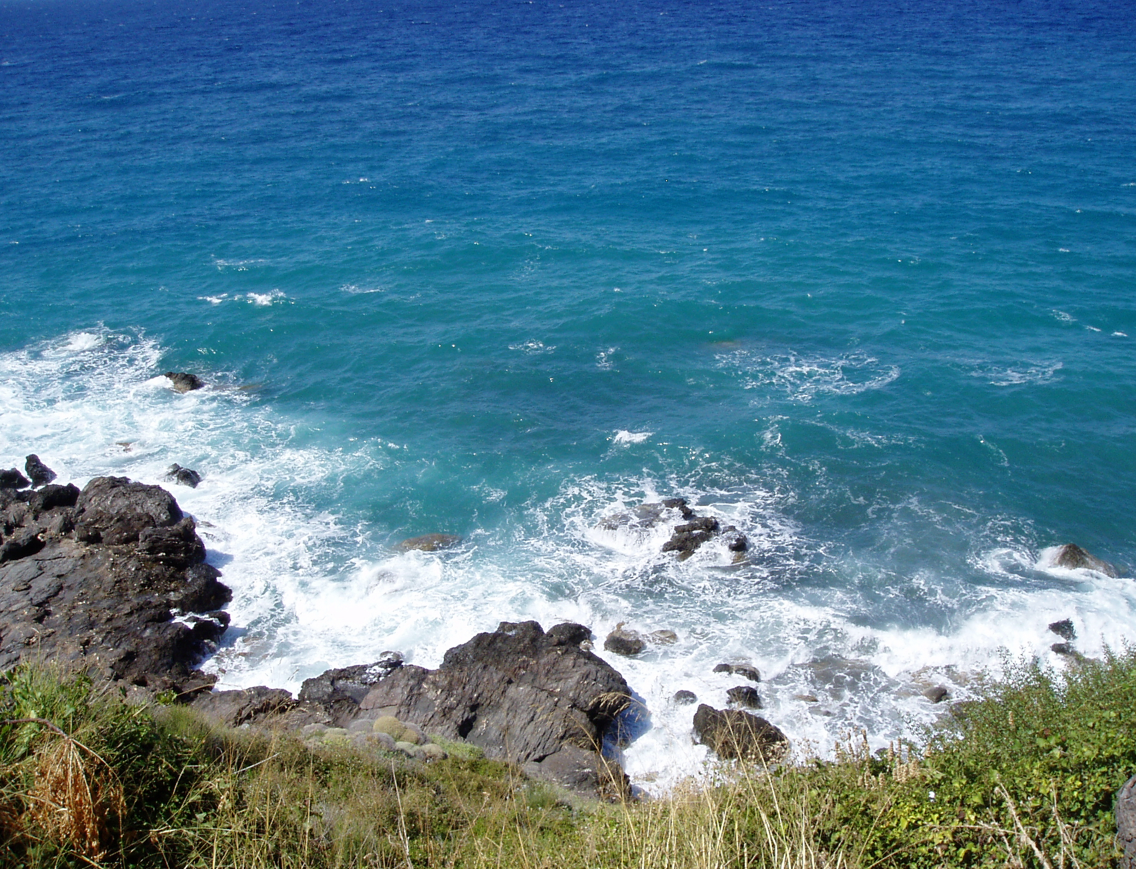
All Almighty God,
long-suffering and of great goodness:
I confess to you,
I confess with my whole heart
my neglect and forgetfulness of your commandments,

Slide 2
my wrong doing, thinking, and speaking;
the hurts I have done to others,
and the good I have left undone.

Slide 3
O God, forgive me, for I have sinned against you;
and raise me to newness of life;
through Jesus Christ our Lord.
Amen.

