Slide 1
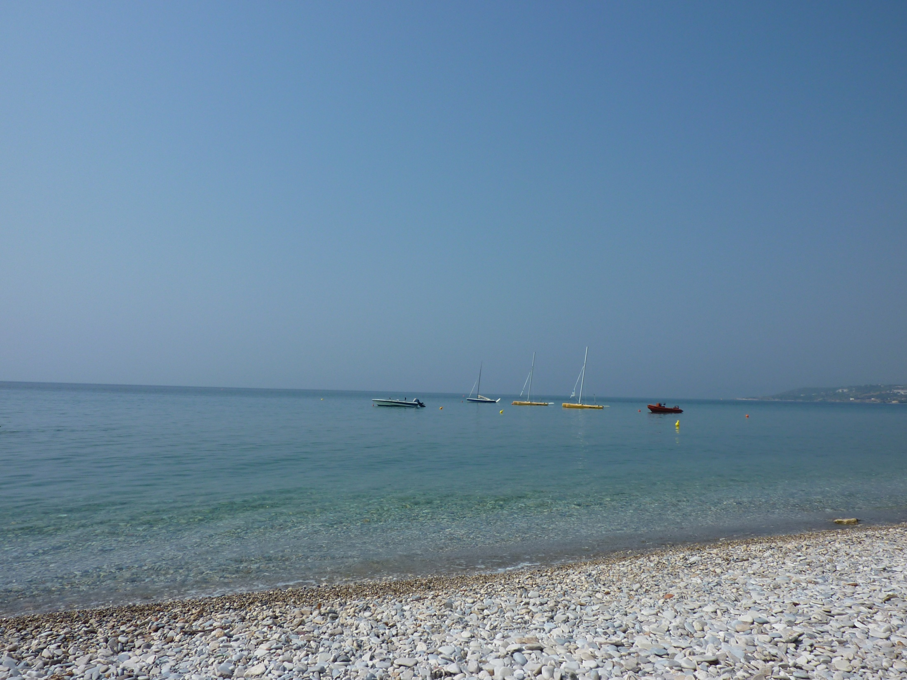
All My God, for love of you
I desire to hate and forsake all sins
by which I have ever displeased you;
and I resolve by the help of your grace
to commit them no more;
and to avoid all opportunities of sin.
Help me to do this,
through Jesus Christ our Lord.
Amen.

