Slide 1
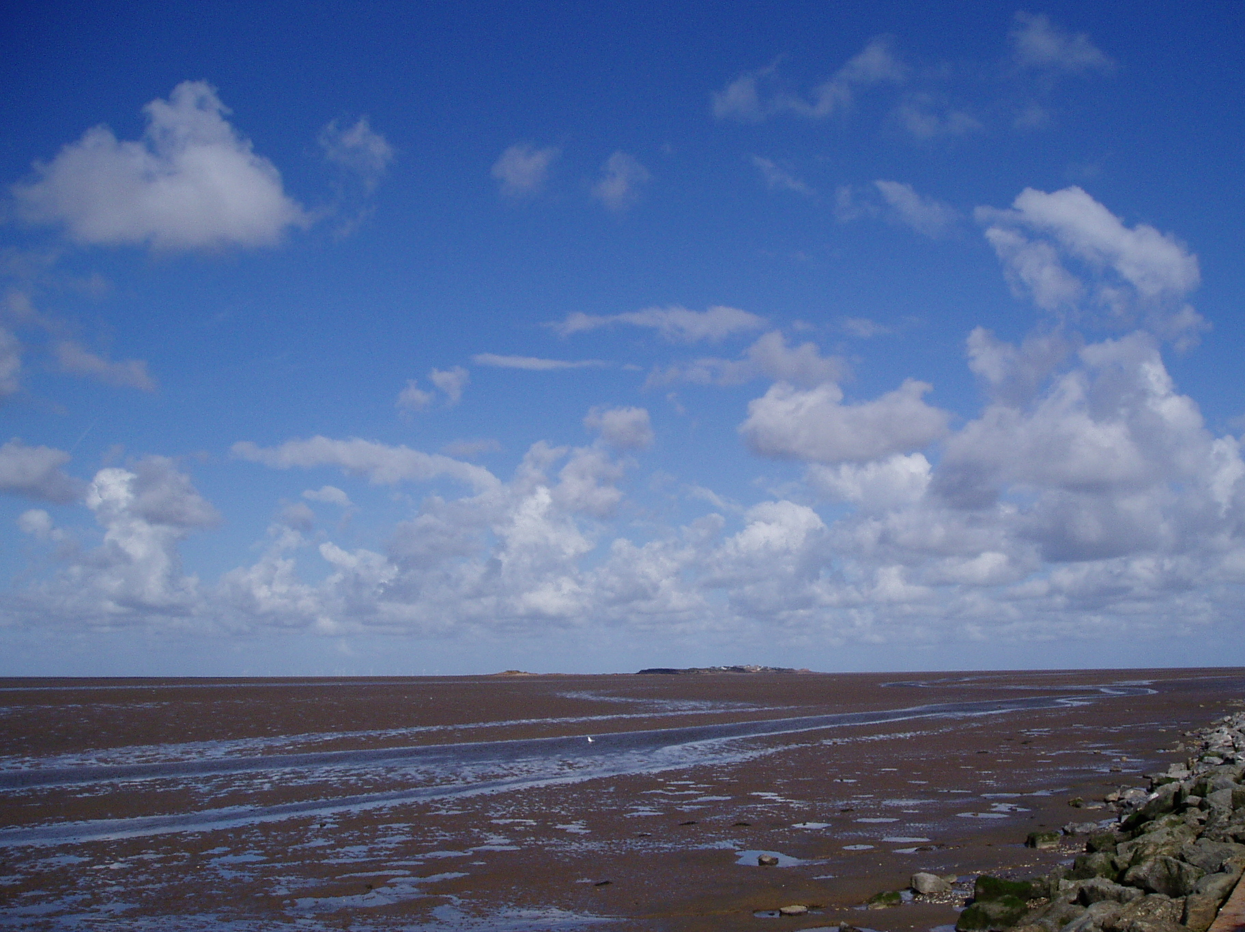
Do you believe and trust in God the Father, source of all being and life, the one for whom we exist? I believe and trust in him.

Slide 2
Do you believe and trust in God the Son, who took our human nature, died for us and rose again? I believe and trust in him.

Slide 3
Do you believe and trust in God the Holy Spirit, who gives life to the People of God and makes Christ known in the world? I believe and trust in him.

Slide 4
This is the faith of the Church.
All This is our faith.
We believe and trust in one God,
Father, Son and Holy Spirit. Amen.

