Slide 1
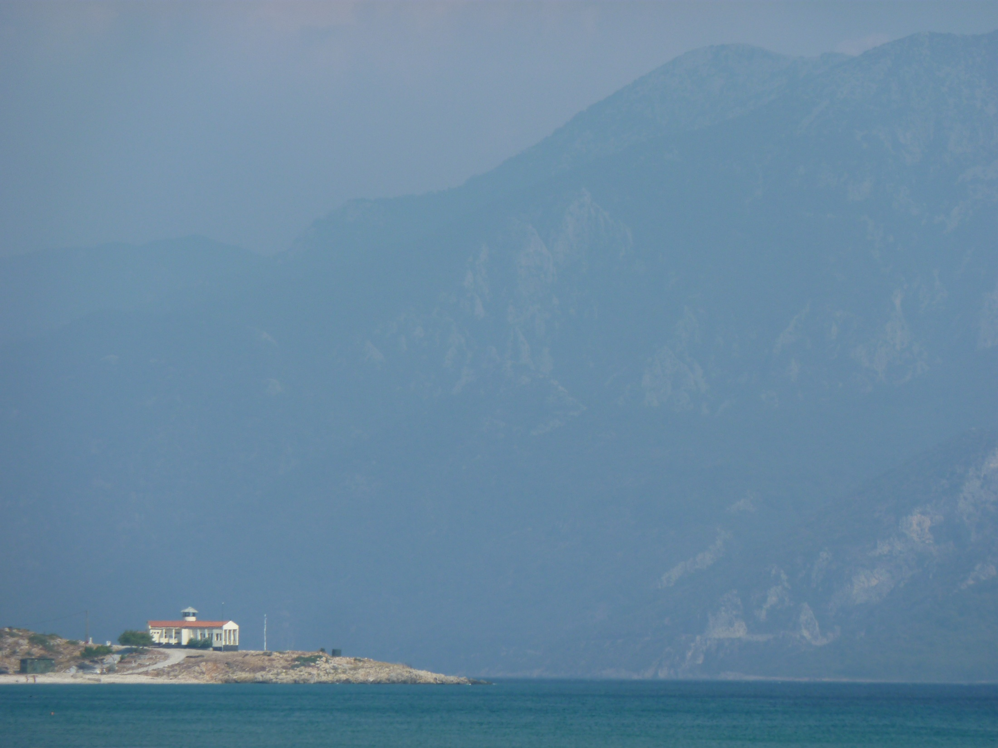
All We believe in God the Father,
God almighty, by whose plan
earth and heaven sprang to being,
all created things began.
We believe in Christ the Saviour,
Son of God in human frame,
virgin-born, the child of Mary
upon whom the Spirit came.

Slide 2
Christ, who on the cross forsaken,
like a lamb to slaughter led,
suffered under Pontius Pilate,
he descended to the dead.
We believe in Jesus risen,
heaven's king to rule and reign,
to the Father's side ascended
till as judge he comes again.

Slide 3
We believe in God the Spirit;
in one Church, below, above:
saints of God in one communion,
one in holiness and love.
So by faith, our sins forgiven,
Christ our Saviour, Lord and friend,
we shall rise with him in glory
to the life that knows no end.

