Slide 1
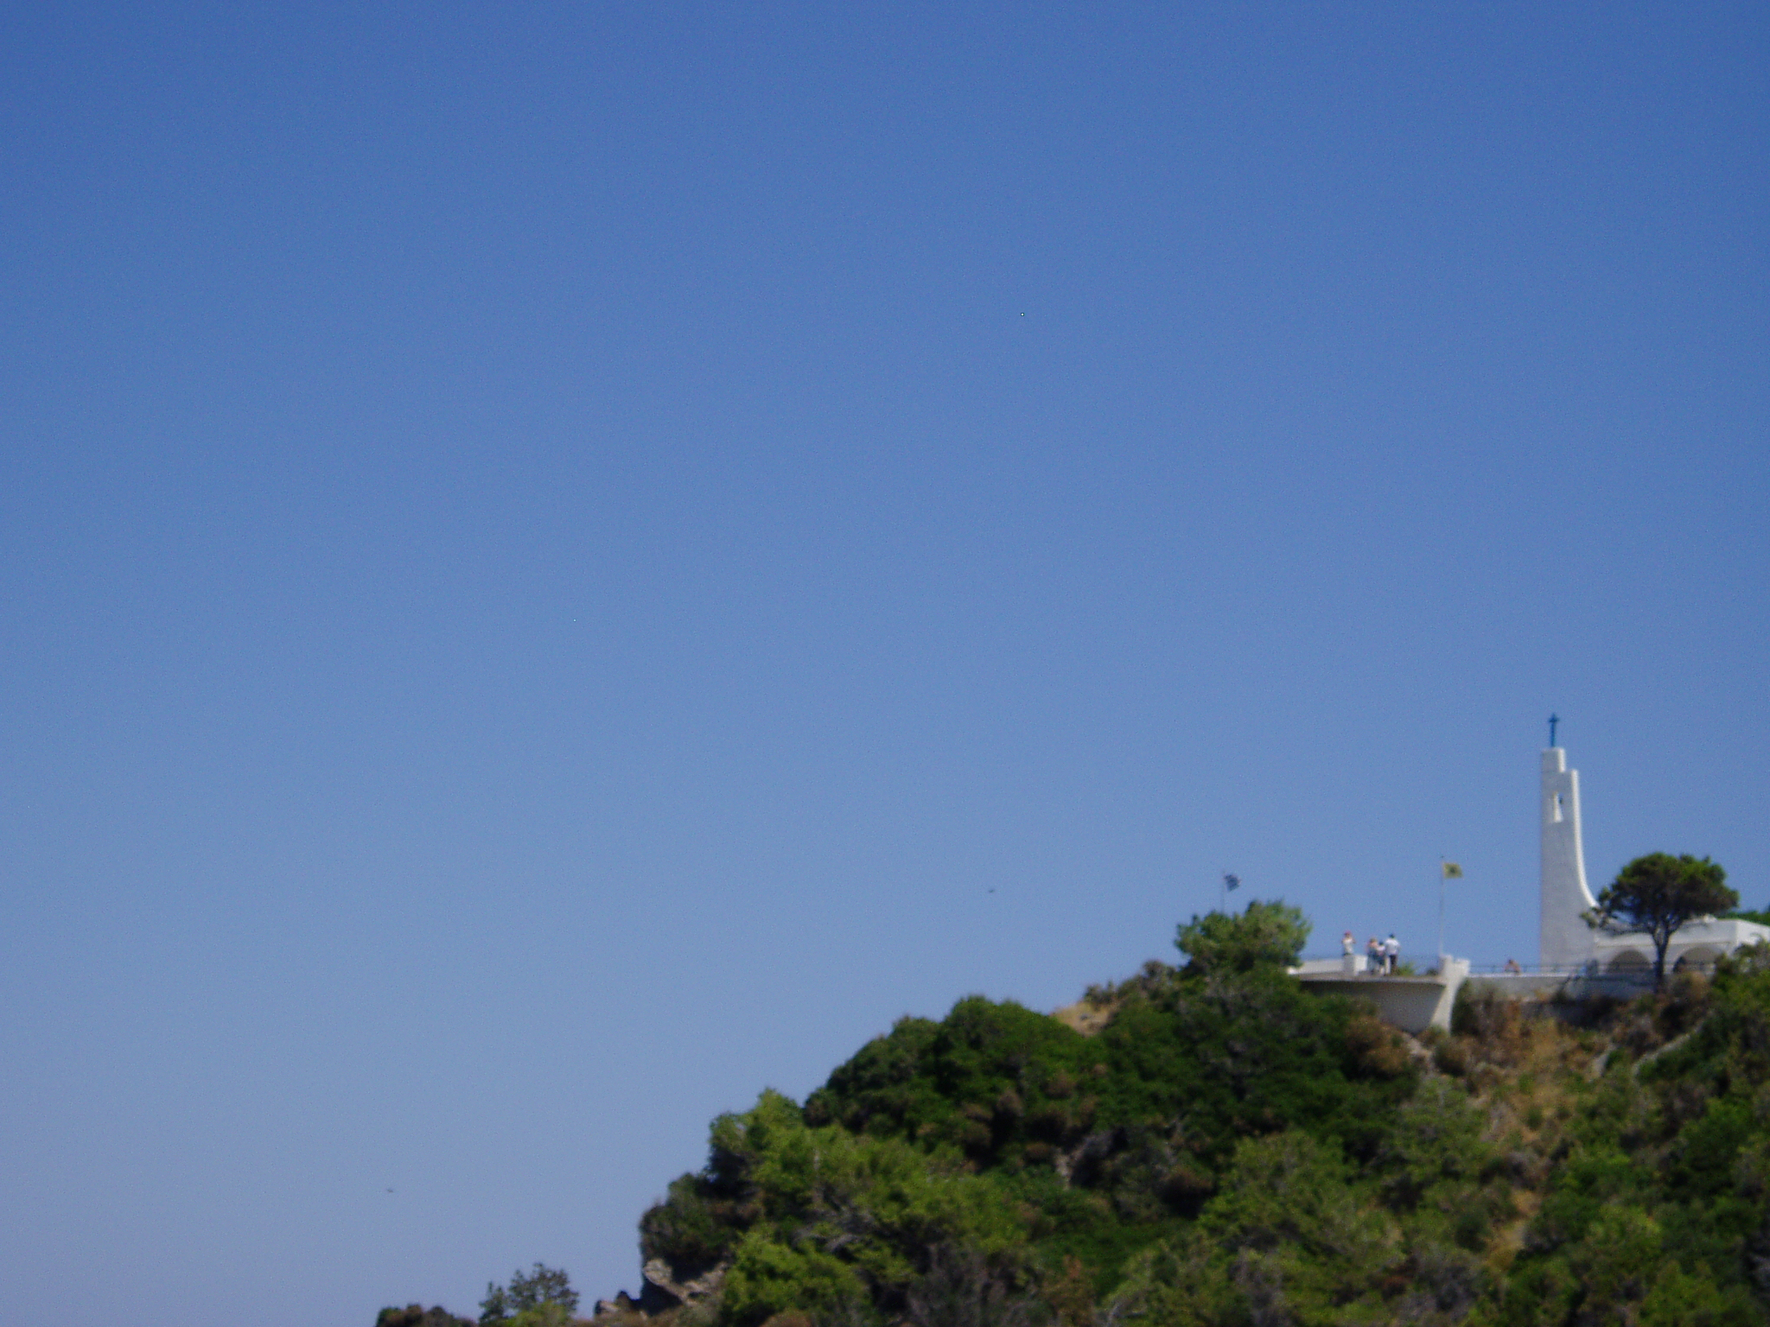
Let us affirm our faith in Jesus Christ the Son of God.
All Though he was divine,
he did not cling to equality with God,
but made himself nothing.
Taking the form of a slave,
he was born in human likeness.
He humbled himself
and was obedient to death,
even the death of the cross.

Slide 2
Therefore God has raised him on high,
and given him the name above every name:
that at the name of Jesus
every knee should bow,
and every voice proclaim that Jesus Christ is Lord,
to the glory of God the Father.
Amen.

