Slide 1
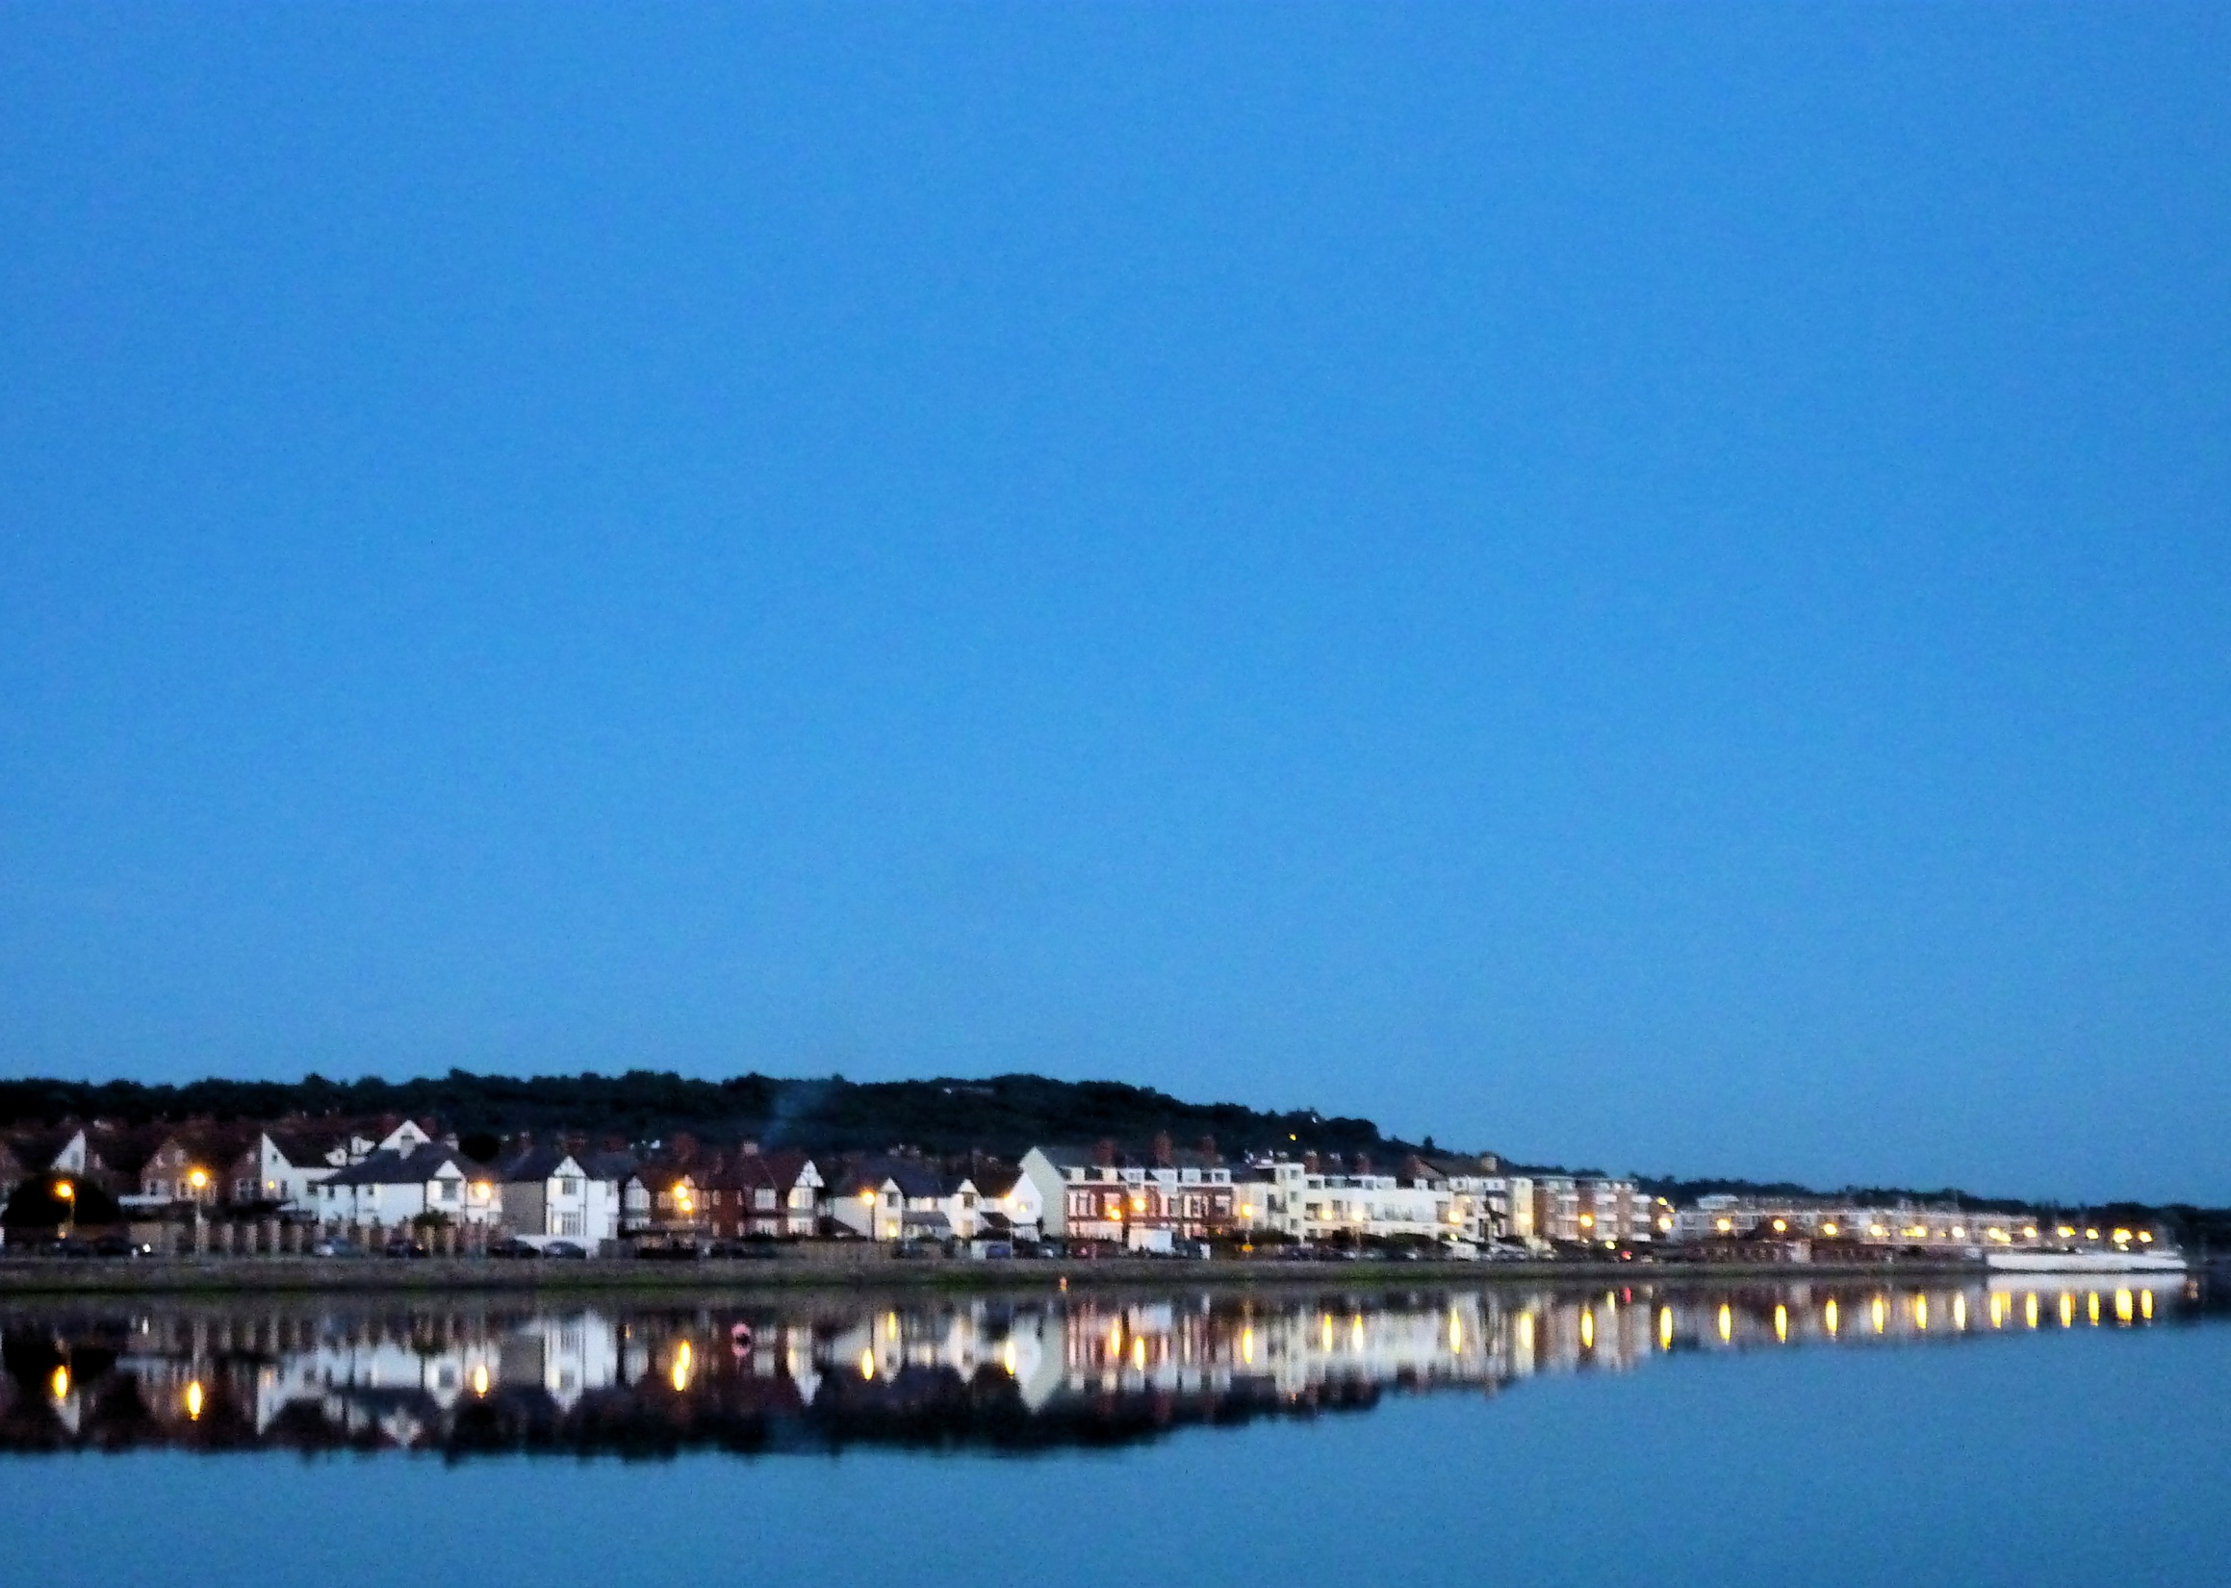
Let us declare our faith
in the resurrection of our Lord Jesus Christ.
All Christ died for our sins
in accordance with the Scriptures;
he was buried;
he was raised to life on the third day
in accordance with the Scriptures;
afterwards he appeared to his followers,
and to all the apostles:
this we have received, and this we believe.
Amen.

