Slide 1
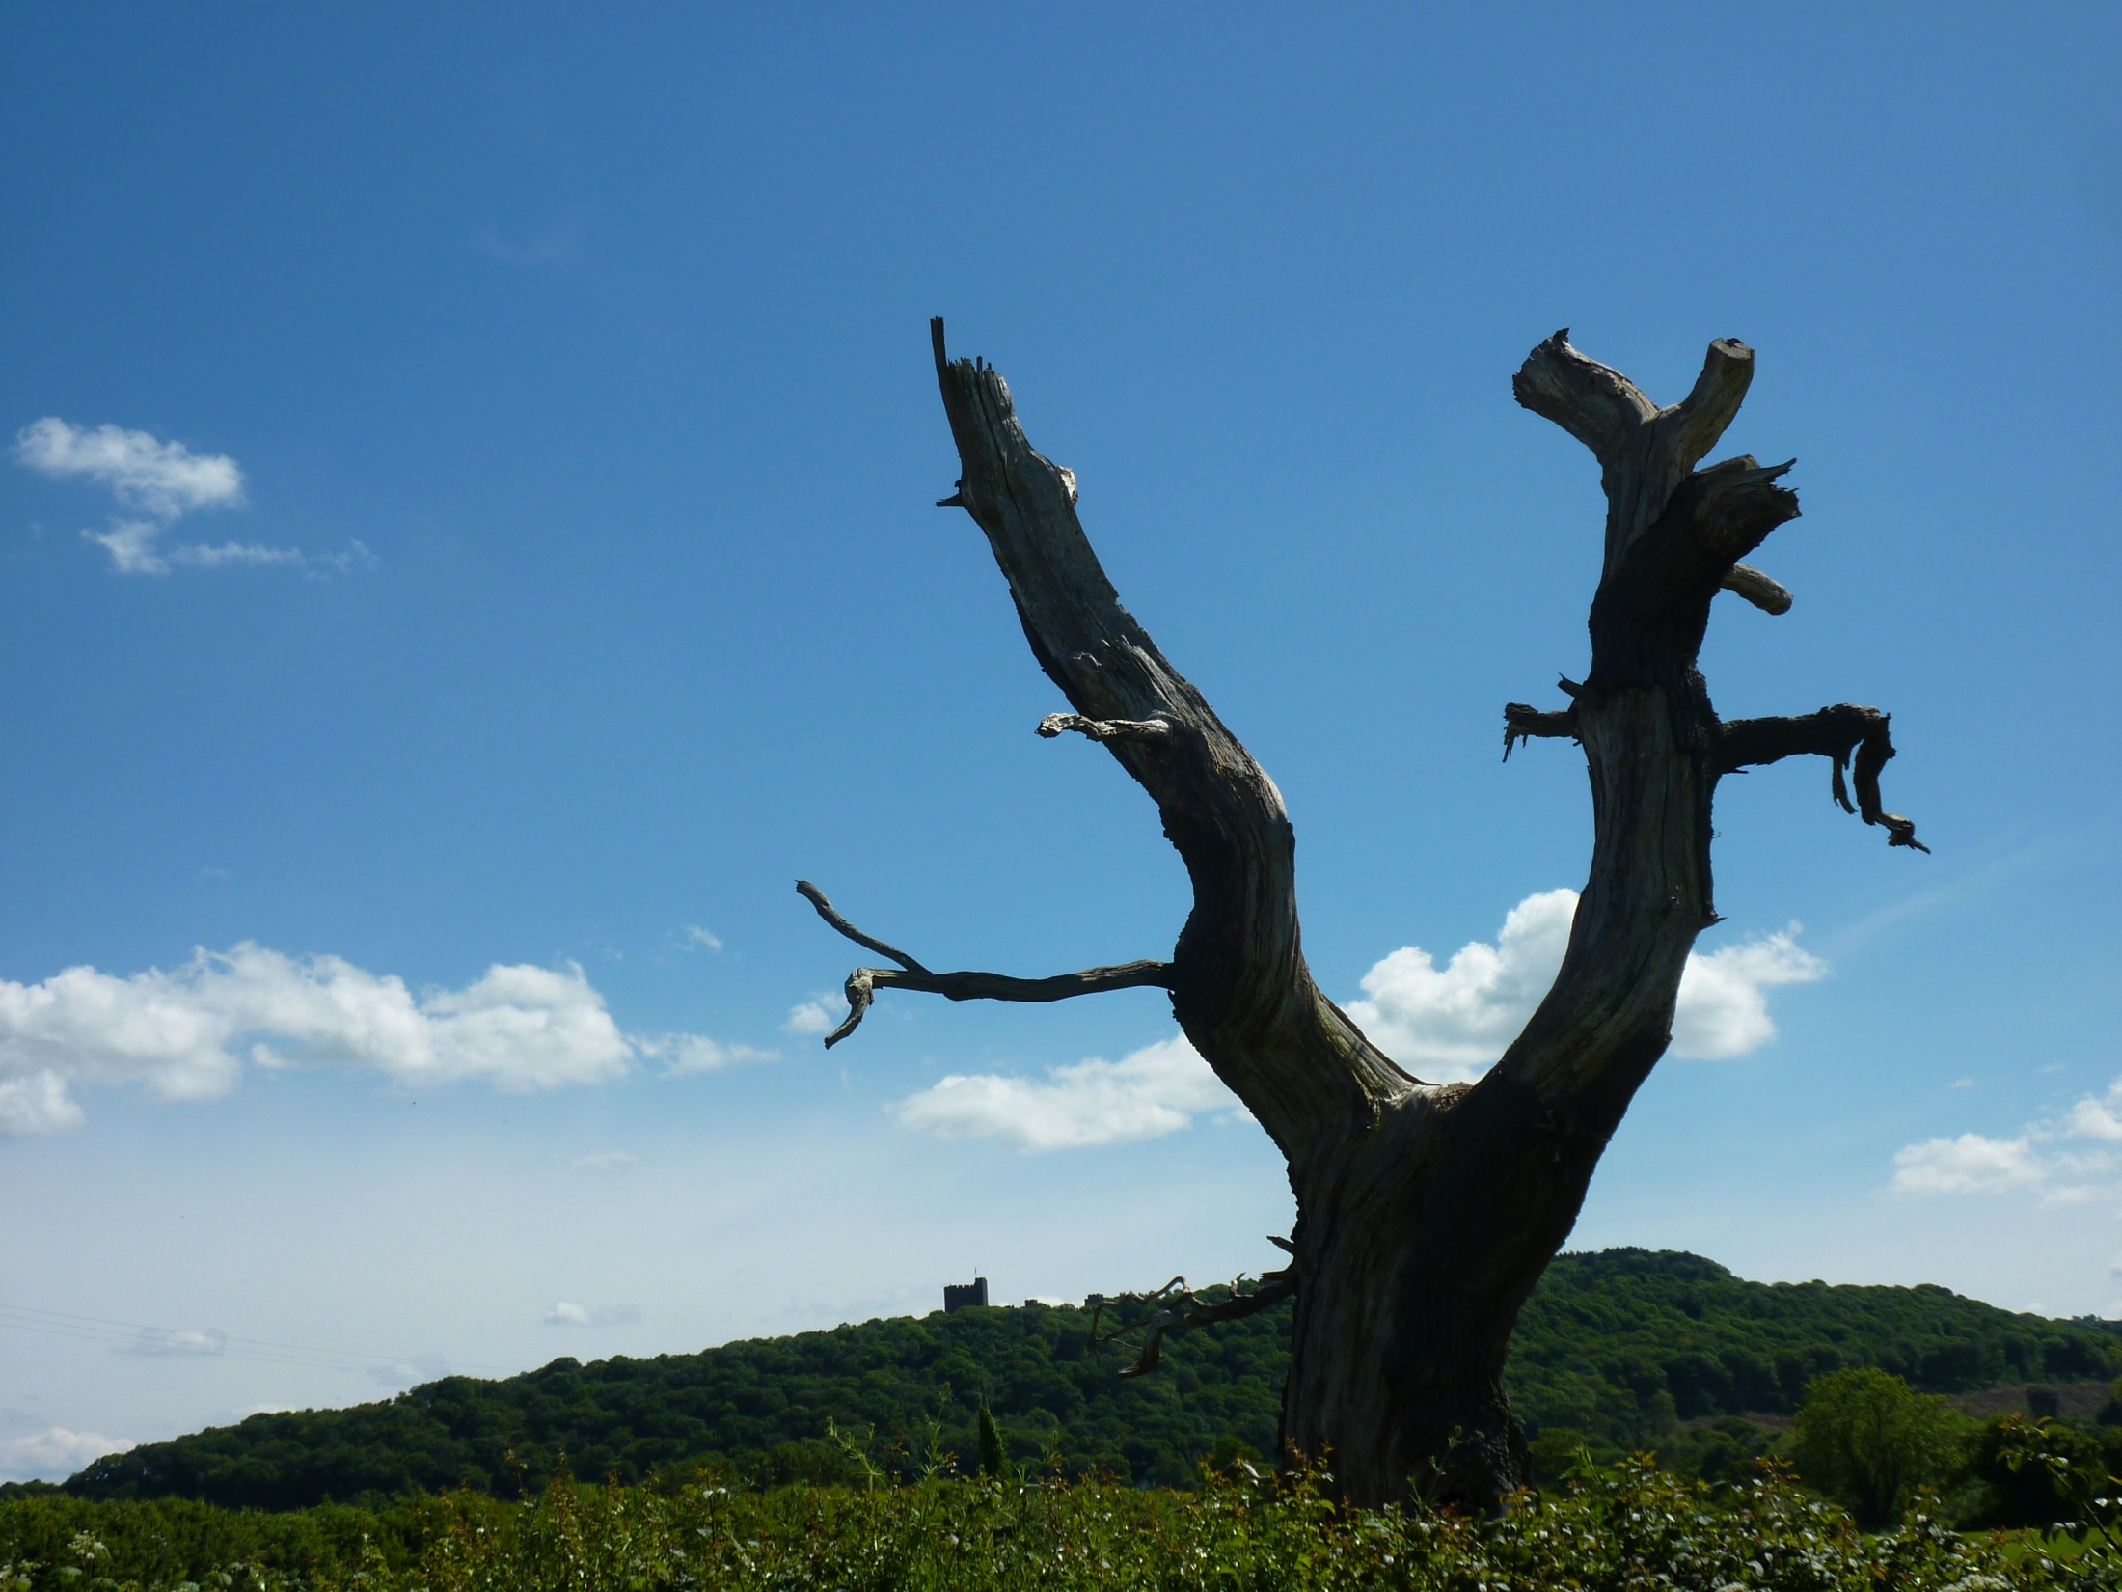
Let us declare our faith in God.
All We believe in God the Father,
from whom every family
in heaven and on earth is named.
We believe in God the Son,
who lives in our hearts through faith,
and fills us with his love.

Slide 2
We believe in God the Holy Spirit,
who strengthens us
with power from on high.
We believe in one God;
Father, Son and Holy Spirit.
Amen.

